Slide 1

SYRIATEL Telecommunication: customer churn analysis & predictive model
ANN MAUREEN WANGUI NGINA

Slide 2
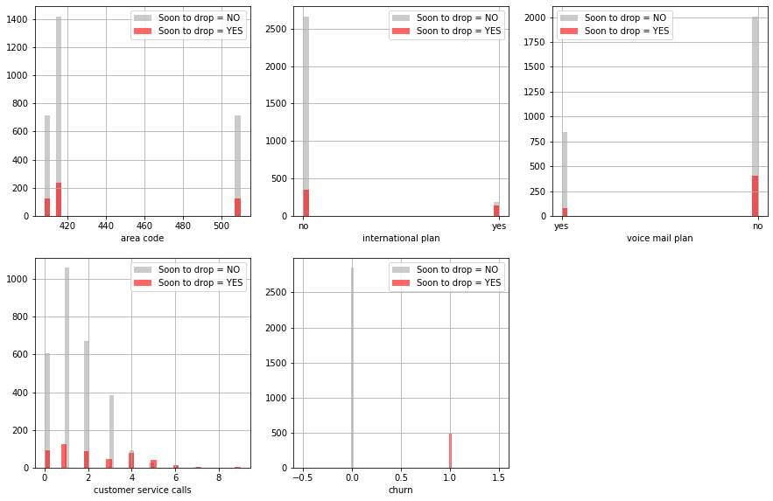
Relationship of the variables with our dependent variable.

Slide 3
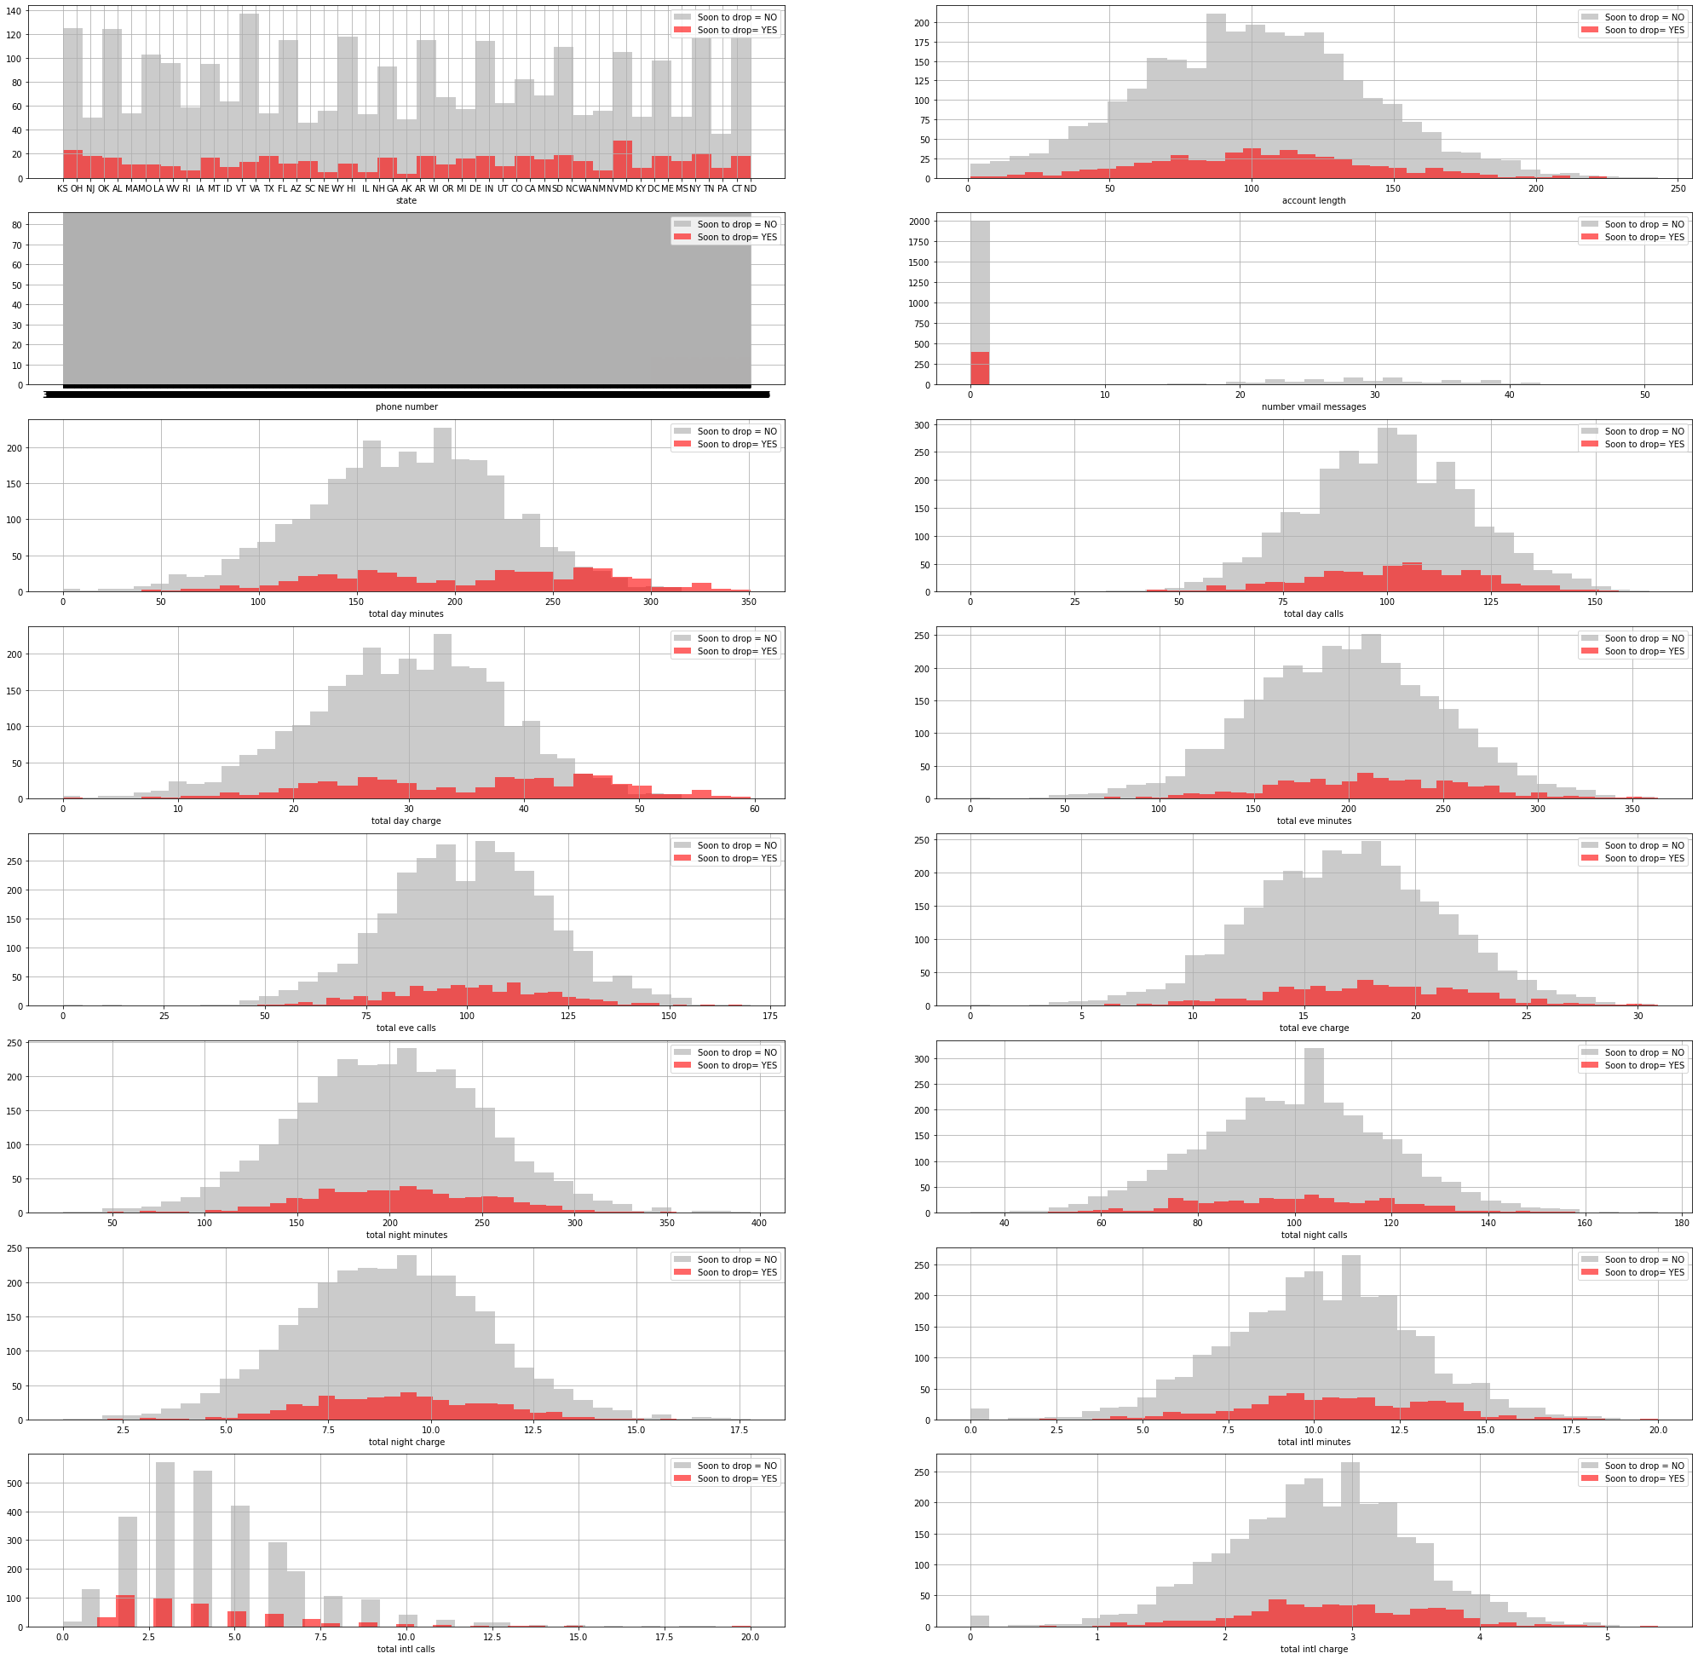
RELATIONSHIP OF THE CONTINUOUS VARIABLES WITH OUR DEPENDENT VARIABLE.

Slide 4
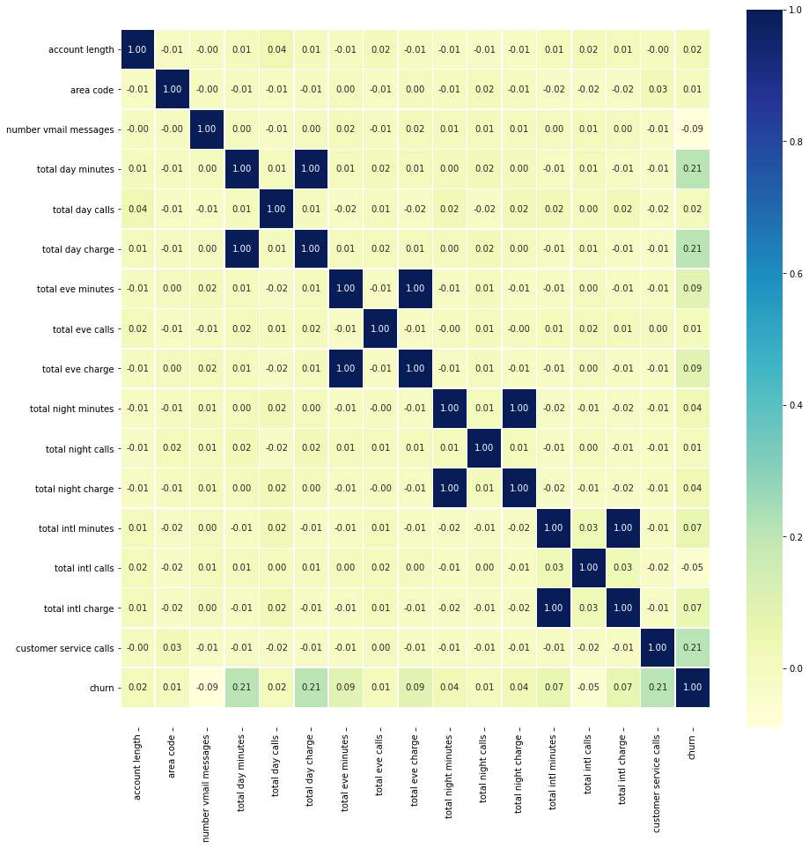
Correlation Matrix

Slide 5
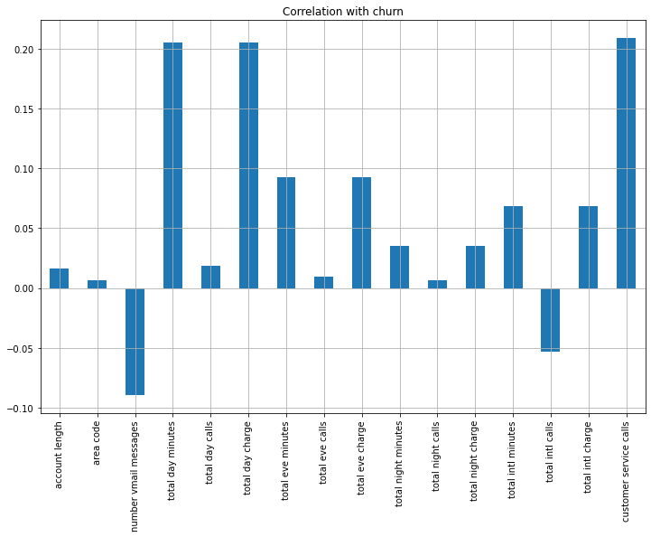
CORRELATION OF INDEPENDENT VARIABLES WITH THE DEPENDENT VARIABLE.

Slide 6
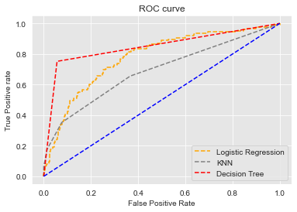
Conclusion
The choice we will use as our model is the Decision Tree as we can see from the graph it’s the one on the most left. It’s the one we will use to predict the number of customers to drop off soon.

